Slide 1
Yearly Report 2012:
Center for Nanotechnology and Molecular Materials
at Wake Forest University
David L. Carroll PhD.
Director
Reynolda
Oana Jurchescu PhD.
Richard Williams PhD.
David Carroll PhD.
Abdou Lachgar PhD.
Ron Noftle PhD.
Affiliates
Medical Center
Steve Akman MD.
Suzy Torti PhD.
Frank Torti MD.
Thomas Smith PhD.
Beth Smith PhD.
Aaron Mohs PhD.
Ravi Singh PhD.
William Wagner PhD.
Nicole Levi PhD.
~ 20 associate members on both Reynolda and Medical. This varies from year to year.

Slide 2
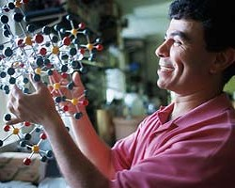

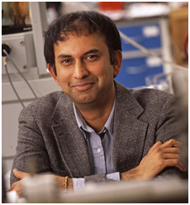
Organization
Executive Committee
Dr. Mark Welker (Chemistry)
Dr. Keith Bonin (Physics)
Dr. Abdou Lachgar (Chemistry)
Dr. Richard Williams (Physics)
External Advisory Board
Dr. P.M. Ajayan (Rice U)
Dr. S. Roth (MPI-Stuttgart)
Dr. W. Blau (Trinity College)
Dr. A. Rubio (San Sebastian)
Dr. G. Wallace (Wollongong)
A representative from the EAB will be visiting June 20 through June 23

Slide 3
Mission Statement
Establish a world class program in advanced materials research
Enhance educational opportunities for WFU undergraduate and graduate students
Provide a gateway for WFU communities into nanomaterials and nanosciences research (infrastructure enhancements)
Develop economic opportunities for WFU through commercialization efforts of Nanotech Innovations
Engage the broader community
Research
Education
Capabilities
Benefits
Outreach

Slide 4
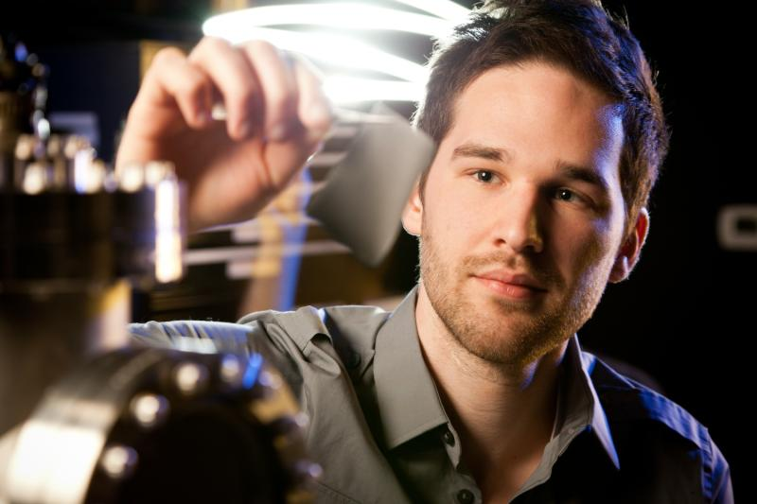
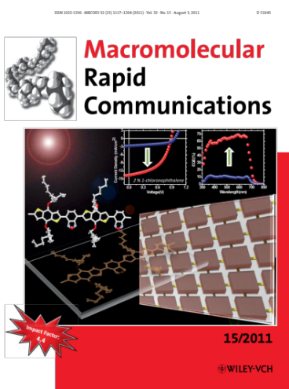
Metrics: Research
2011 – 2012 publication record*
21 publications that list Nanotech
4 biomedical
5 organic electronics
3 inorganic devices
9 organic solar
1 cover article featuring our work
2 news releases (featured in NY Times, Daily Mail (UK), Science Daily, Gizmodo, etc.)
Nanotech was founded in 2004. In the time NANOTECH has been at Wake:
We have authored ~91 indexed publications (over 100 with popular articles counted)
We have been cited 2400 times (average > 24 citations per paper)
We have achieved an h-index of 22 (counting only papers from 2004 -)
Achieved 3 cover articles.
*All affiliate members are actively involved in collaborative work within the Center. Some collaborations do not use Nanotech facilities. We track only publications that specifically identify the Center for funding or support.

Slide 5
Metrics: Research
Other Measures of Impact*
In the 2011 – 2012 academic year Nanotech scientists have:
Welcomed 3 international guest scientists
Sent 4 PhD. students to be guest scientists in labs across the world
Delivered 5 invited talks at international level forums
Sponsored 12 student presentations at MRS (spring and fall): Better than Vander. Emory, Dart.
Collaborated across 4 continents
Given 2 radio interviews and 3 television interviews
Won top innovator award for all of WFU (based on patent filings)
Served on 4 funding review panels
Hosted a program review by an AFOSR program manager
*Self reported by affiliates.

Slide 6
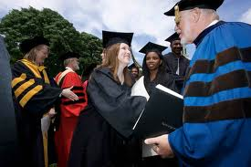
Metrics: Education
For the 2011-2012 academic year Nanotech has produced:
4 Undergraduate thesis studies
1 biomedical
1 sensors and bionics
2 organic electronics
2 Masters Degrees (both physics)
3 PhDs.
1 Biomedical
2 Physics (Yuan Li’s thesis will be published by Springer Verlag)
Yuan won best student from China award this year
New Courses taught:
PHYS690 – Materials analysis using electron microprobes
(enrollment 4 graduate students)
Seminars: 2 guest speakers

Slide 7
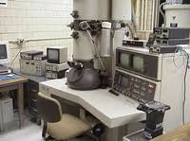
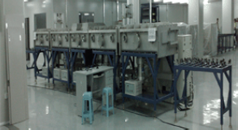
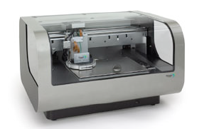
Metrics: Infrastructure
This year Nanotech has enhanced its capabilities significantly through the use of external funding:
Upgraded its HRTEM to include EDAX
Added scanning Auger (PHI)
Added XPS (PHI)
Added a 10 MW prototyping PECVD line
Installed a second sputtering system
Added a 3D rapid prototyping printing system
Upgraded its UHV VT scanning probes system
Added a digital imaging system to its JEOL 1200 TEM
Added flash chromatography to its synthesis labs
Added a new glovebox system
Upgraded the cleanroom to class 1000

Slide 8
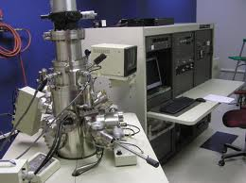
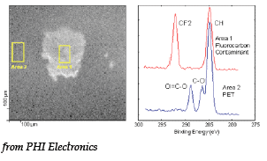
Highlights: Infrastructure
The addition of the PHI 600 scanning Auger – XPS system gives WFU Nanotech the ability to map chemical composition across a number of different materials families.
The system couples its scanning electron microprobe with AugerScan 3, the latest in software analysis that can perform curve fitting to determine chemical shifts in the auger peaks allowing us to distinguish between different bonding environments of a given component.
Added to this is an X-ray photoelectron spectroscopy system. When used in conjunction with the HRTEM’s new oxford instruments EDAX system, WFU now has complete materials characterization capabilities down to the nanometer scale.

Slide 9
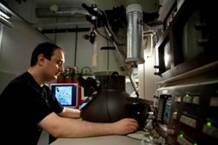
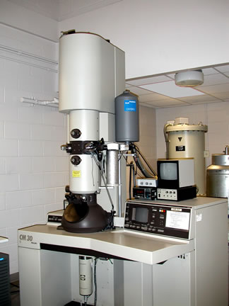
Highlights: Infrastructure
The Technai CM30’s sophisticated
new nano-probe system completely
transforms our instrument with digital
image processing capabilities as well
as materials analysis.
This new system provides ~3 nm resolution on analytical mapping as well as sub 0.3 nm high resolution images. We anticipate adding Cs correction to the device as well bringing the instrument to > 0.1nm resolution capabilities.
-> this makes us a 2nd tier imaging facility with capabilities rivaling everyone except ORNL(tier I) in the southeast.
-> we have the best user to instrument ratio (2) of any tier 2 facility in the U.S. that we could obtain numbers for.
-> this instrument has a full time tech.

Slide 10
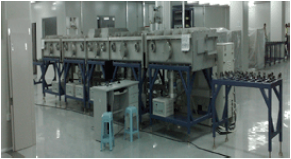
Highlights: Infrastructure
The Nanotech center has long been known for its work in organic PV and organic electronics (OLEDs, etc.) While this effort continues to be a mainstay of our program, in 2011-2012 Nanotech launched a major new initiative in inorganic electronic materials.
With a technology engineering focus, our new program will be centered around a silicon PECVD installation now under way. Plasma Enhanced Chemical Vapor Deposition techniques are the industrial standard for the creation of solar panels and large arrays of LEDs. Our system is setup to deliver triple junction Si solar panels at an industrial level of 10 MW per year. It will be used to benchmark new manufacturing approaches to such systems thereby lowering prices, and developing best engineering practices.
It is the largest such alpha line at a university in the southeast.

Slide 11
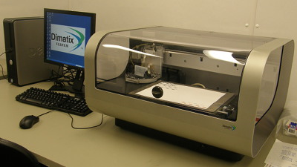

Highlights: Infrastructure
The Nanotech Center’s new DIMATIX prototyping print system from Fuji provides unparalleled, software controlled patterning in 3D.
Ink Jet printing is rapidly becoming the processing of choice in the thin film organic electronics industry. The addition of this new technology to our clean room has allowed us to create state of the art organic circuits in 3D.
The DIMATIX can also be used to print human tissues together with organic circuit embeds…

Slide 12
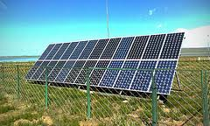
Highlights: Coming Attractions
This summer Nanotech is embarking on the creation of new outdoor testing facilities for solar-thermal panels. The first of its kind in the southeast, this facility will allow tracking of meteorological conditions and direct correlation to solar performance over the course of the year. It will be located on Center grounds and open to corporate users (for a fee) to determine local solar assets and panel performance.
Together with the Class A standards maintained by the Center, this new facility will help to further establish WFU as a national leader in solar research.

Slide 13
Metrics: Facilities Use
JEOL 6550 usage
Currently the Nanotech Center has a number of users of the facilities. Use is currently free for most internal users.
Orthopedics
Cancer Biology
Microbiology
Plastic Surgery
Phys Pharm
Physics (Carroll and Jurchescu)
Cook Medical
NanotechLabs
CeeLite Inc.
DynaMax
Regen. Medicine
Some operate under a FUA
The Center generate quarterly reports to track all users in each of the core facilities. We now have a mechanism for outside charges and are just beginning implementation. We are currently operating at 50% of capacity (up from last year)

Slide 14
Highlights: Benefits - Budgets
How much does NANOTECH take to run? *
Equipment/ Facilities Costs: Service contracts, upgrades and facilities modifications, repairs, clean room filters and certification… $98,000.00
Staff: Baxter McGuirt (microscopist) ~ $45K
Facilities Maintenance: Lawn, painting, repair to doors, leak in roof, etc. … $5000.00
Building payback: As of 2011 – 2012 academic year. Nanotech has paid off its $ 900K loan to establish its physical facilities.
Outreach: sponsor Lego League, hosting girls scout troupes etc…. $20K
Total this year: $168,000.00
Offset by core funding: $50K
External support funding: $ 118,000.00
The Nanotech Center is funded by direct grants and gifts, fees, and indirect return. Our MOU, provides that grants designated “Nanotech” are eligible for indirect return. Currently only Dr. Carroll’s grants generate indirect for facilities operations.
We also receive a core operating budget of $50K/year.
* Estimated amounts. Final budget figures are not yet available

Slide 15
Highlights: Benefits - Funding
How do we get this money?
Microscopy service contracts: $48K Direct funding from CeeLite, CCSolar, DOE, Cook Medical, NIH R01.
Microscopist salary: $ 5K Direct funding from Cook Medical, CeeLite, CCSolar.
Facilities and repairs: $12K Direct funding from CeeLite and CCSolar
2 grants for facilities upgrades: $50K
The remainder ($3,000.00) was recovered from indirect on $677,000.00 expenditures. This is the aggregate amount of grants and contracts spent that has indirect associated with it.
The Center also donated part of its indirect to help with equipment repairs in Chemistry and to buy new items for central facilities use.

Slide 16
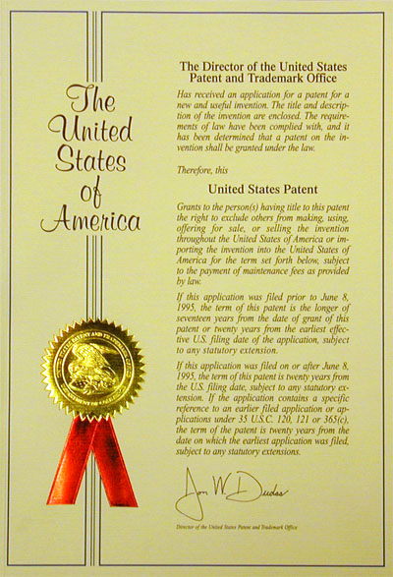
Highlights: Benefits - Patents
In 2011- 2012: a Nanotech Center Scientist took the “most prolific innovator” award, (based on number of patent filings during the year). Nanotech was approximately 70% of all filings from the Reynolda Campus. Nanotech was second only to Regenerative Medicine in filings as a unit across both campuses.
New filings include:
3 FIPEL patents
1 FiberCell patent
1 RFID – based sensor patent
1 tissue regeneration patent
1 cancer hyperthermia patent
Several new patents issued:
1 in Cancer therapeutics
2 in Solar
1 in Lighting

Slide 17
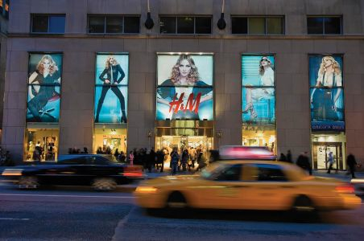

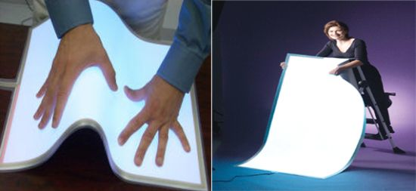
Highlights: Benefits - Licenses
Generating revenue from licenses…
1 license: CeeLite Inc. (three patents)
1 license: CCSolar Inc. (three patents)
1 license: Orthovative Technologies Inc. (1 patent)
Currently in discussions for:
NanoTorr: Orthovative Technologies Inc.
Cancer therapeutic: Medtronics and Boston Scientific
Cancer therapeutic: Santofi Aventis, Alnis
Cancer endoscopy: Cook Medical
WFU has received $10K in revenues from its PureLux patents. We also received $1M in stock from CeeLite Inc.
Negotiations are through: OTAM
Nanotech Business manager:
Bob Summers MBA (WFU)

Slide 18
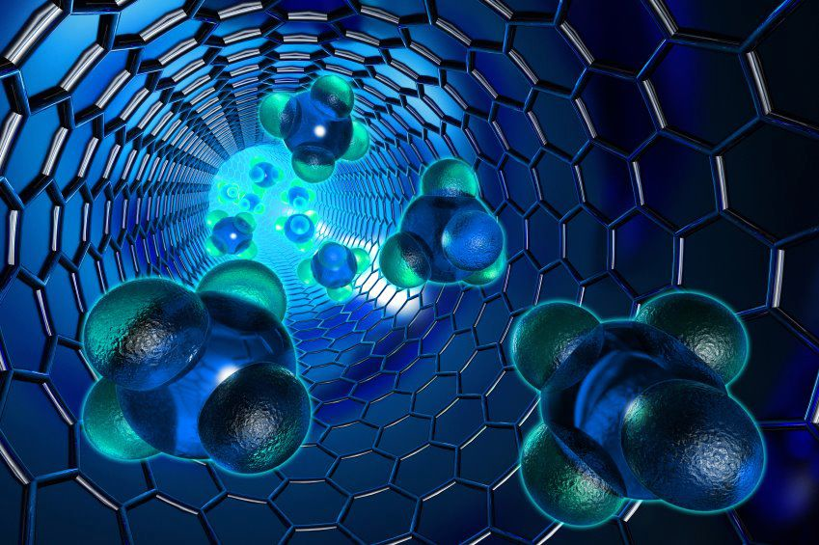
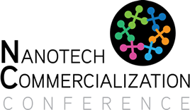
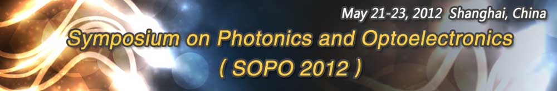
Metrics: Outreach - Conferences
The Marquee conference for the Nanotech Center is held yearly in Stuttgart Germany in collaboration with the Max-Planck Institut für Festkörperforschung and the Fraunhofer Institut IPA. This conference entertains only invited talks and is considered influential in European Policy on Nanotechnology. (150 attendees)
The Center also helps organize the NanoCommercialization conference in NC. This conference moves around NC and was held in Durham this year. (200 attendees)
The Center is a board member of the SOPO conference held in Beijing every year. (400 attendees)
Stuttgart Nanodays

Slide 19
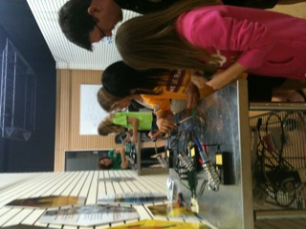
Metrics: Outreach K-12
Sometimes the best students we find in our own back yard. (Jim Grobe)
Sponsored SciWorks Nanodays
Sponsored one middle school Lego League team (included weekly mentoring)
Sponsored the science labs at Hanes (supplies)
Represented at the board of WS CoC, Sciworks and NCSSM (currently seeking a reciprocation agreement with NCSSM).
Talks at: Hanes Middle School, Sherwood elementary, Reagan High (tables at several STEM nights)
Hosted: Two Girl Scout troupes for Science Badges (basic circuits)
Hosted: Awards luncheon for science award winners at Hanes.
Hosted: Two undergrad guest scientists from TCD
Tours of the Nanotech Center are given regularly. This year we have had nine different tour groups. The COMS conference, several school groups, alumni groups, and more. There were multiple individual tours.
I was the only one that got burned in the soldering lesson!
We also held a challenge event that brought BME and Regen. Into the lego league comp.
This was funded through indirect return…

Slide 20
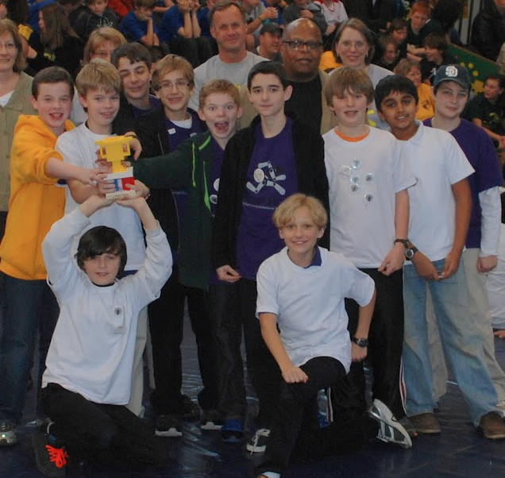
Metrics: Our Lego League team for 2011/2012

Slide 21
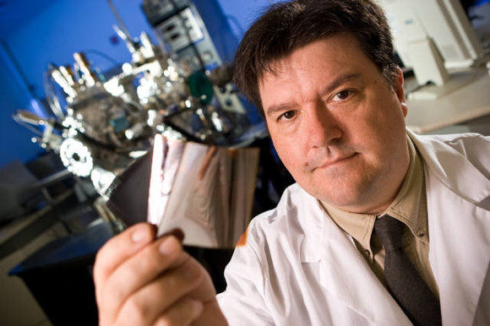
Metrics: Outreach - Community
The Nanotech Center provides talks to local organizations for the promotion of Science in Society. We do not track these carefully but some examples include:
The Retired Methodist Ministers
The Kiwanas
The Winston-Salem Rotary
The Oddfellows
The Winston-Salem CoC
Youth groups of the Moravian Church
REU programs at NCSU
TIPs program of Duke University
Also various appearances on Earth and Sky, Channel 14 news, Discovery News
From Signs of the Times…

Slide 22
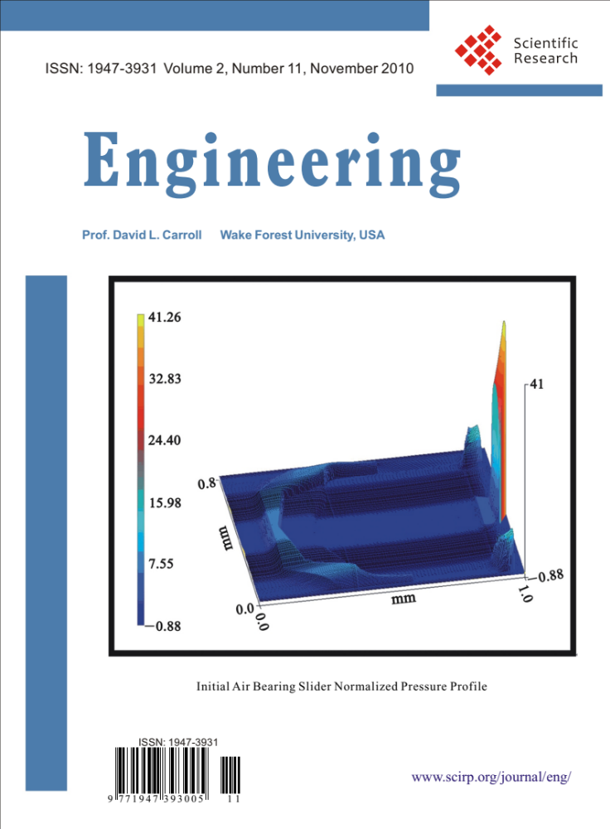
Metrics: Outreach - Journals
As we all are aware, the rising cost of journals continues to impact the overall operation of research libraries across the world. In response to this, the Nanotech Center has become actively engaged in the “open source project.” In the U.S. Cornell has led the way with open source journals, encouraging its researchers to support these journals through publishing in them.
Two open source journals now call Nanotech home. We are the home offices of the editor-in-chief of the journal Engineering (ENG) and the Journal for Biosensors and Bioelectronics (JBSBE).
Both journals boast world-wide circulation

Slide 23
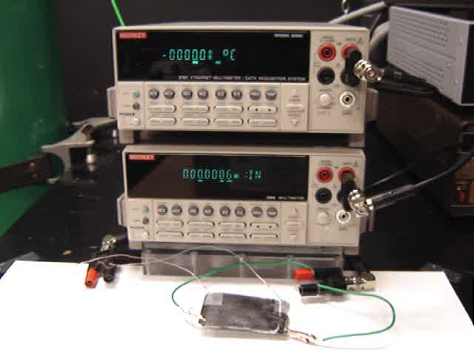
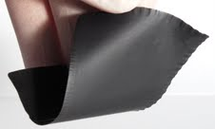
Highlights: Research
“To turn the human body into one of these…” those famous words from the movie Matrix may be a little closer than you think. Nanotech researchers have developed a fabric that can literally generate power from the body’s heat. Because of its unique form factor – that of a flexible felt, the material can be applied nearly anywhere at ultra-low cost. A few simple estimates:
A plane outfitted with PowerFelt in the seats could run its entertainment system through the heat given off by passengers.
Your sheets could recharge your MP3 player while you sleep
The dashboard in your car may soon be run entirely from the waste heat of the engine.
Recently featured in the NY Times and Bloomberg Business

Slide 24
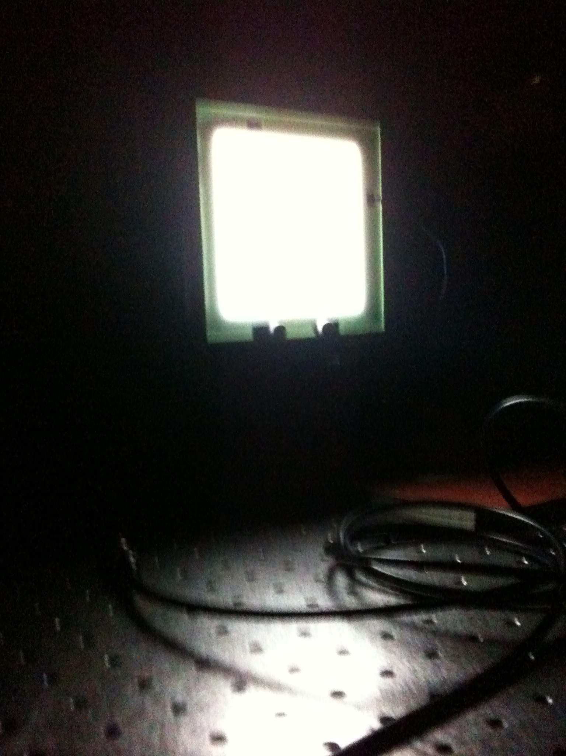
Highlights: Research
FIPEL: the introduction of the first new light bulb in 20 years.
Nearly 30% of all electricity generated in the U.S. goes into lighting.
There have been some advances, the fluorescent bulb, the LED, but fundamentally these technologies are just refinements of older ways of doing things.
WFU FIPEL is a wholly new way of generating light for homes and office buildings. Through the use of molecular engineering we have created a range of new materials that, when integrated into the unique FIPEL design, completely changes the way we think of a light bulb: with longer life, brighter output, and more efficiency.
Physics/Chem - Licensed to CeeLite

Slide 25
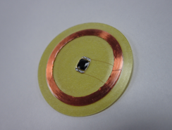
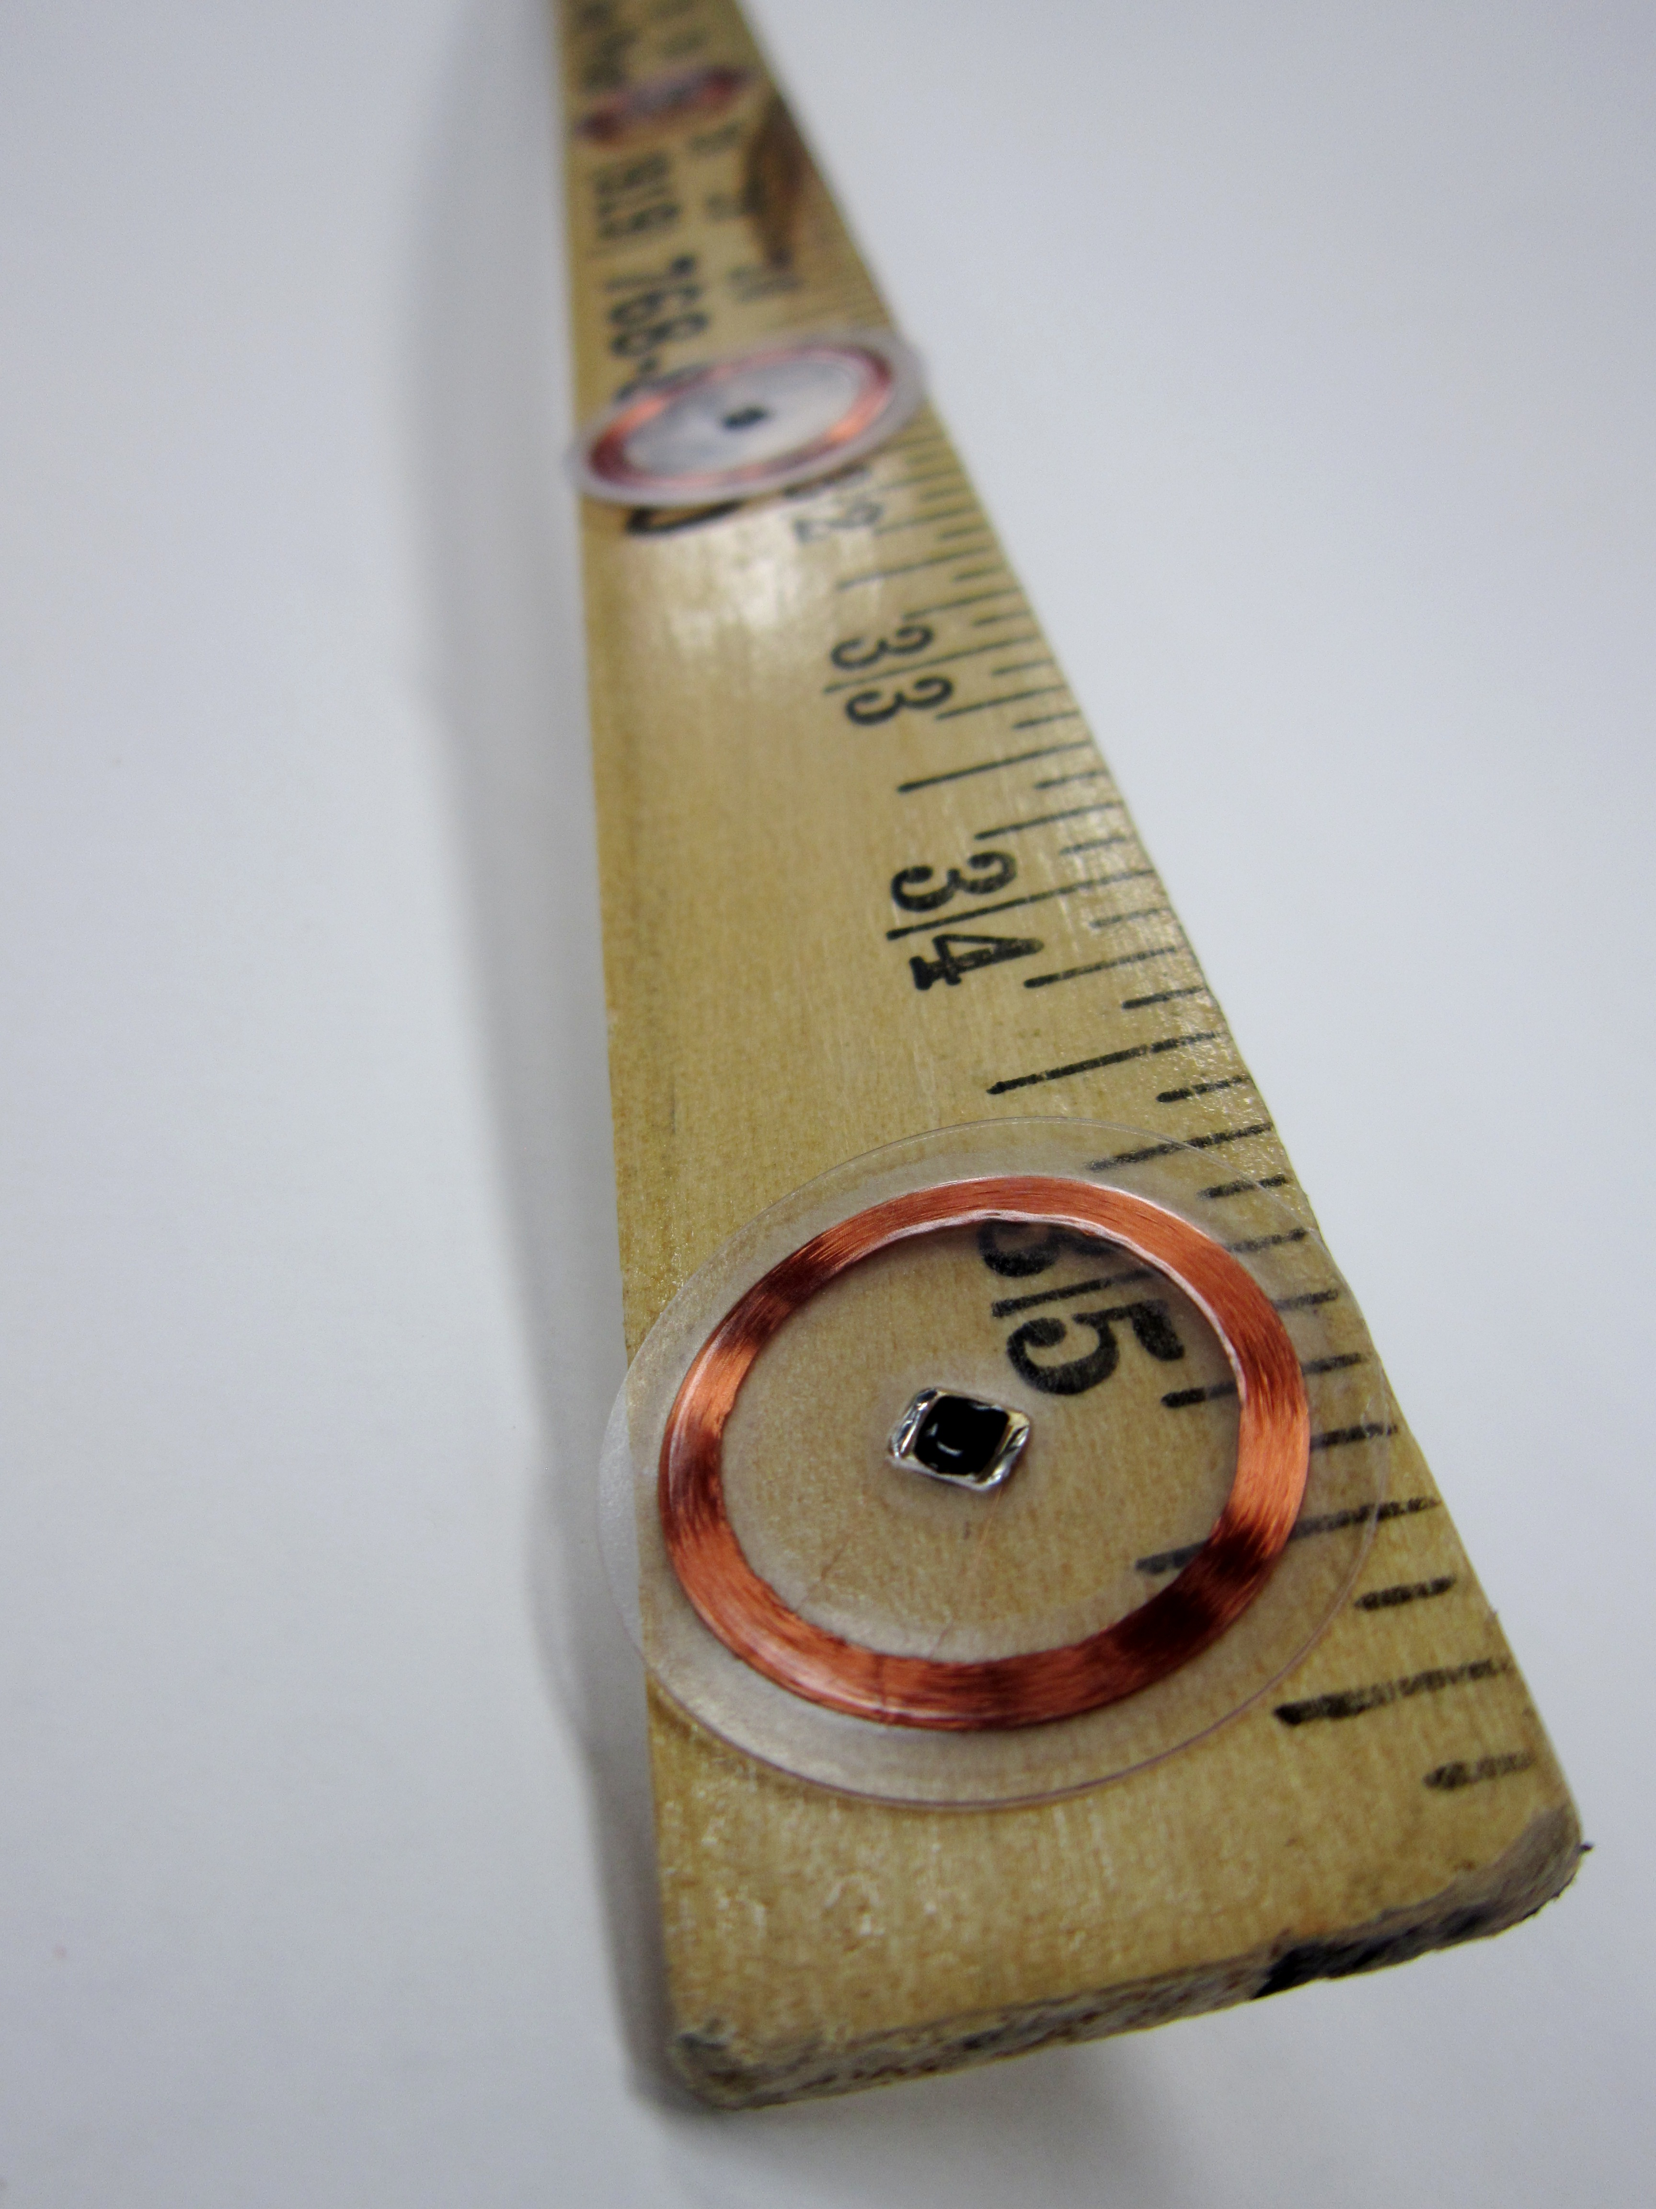
Undergraduate thesis project: Molly Binder
Highlights: Research
Back Pain? There’s an app for that…
The next step in medical care.
An RFID-based sensor technology capable of measuring strain, temperature, and shear.
These new sensors adhere to the skin similar to the common nicotine patches used by smokers to quit. But using an embedded RFID chip, they can communicate muscular-skeletal alignment, along with other physiological measures, to physicians to understand how misalignments in the "frame" of a person (or dummy) can lead to injury and/or chronic pain.
These tags are more than just a new type of sensor, they will become a new type of medicine: because they use the resources of the world wide web to communicate, store, and analyze information. In fact most of the analysis and communications is actually done right through your iphone!
Siri… How am I feeling today…
Ortho/Comp Sci/Physics -Licensed to Orthovative Technologies Inc.

Slide 26
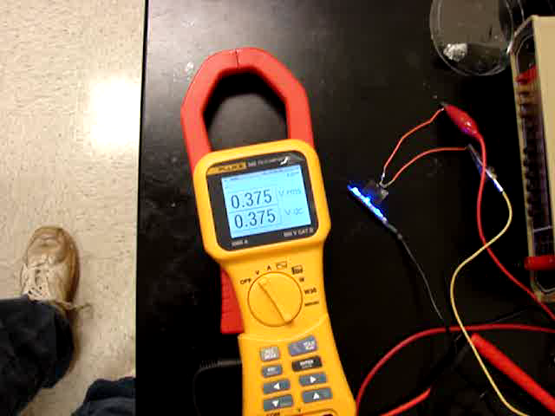
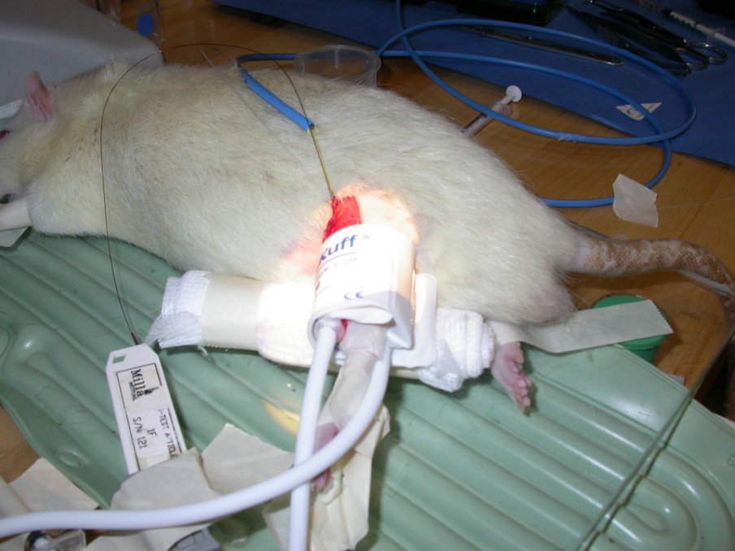
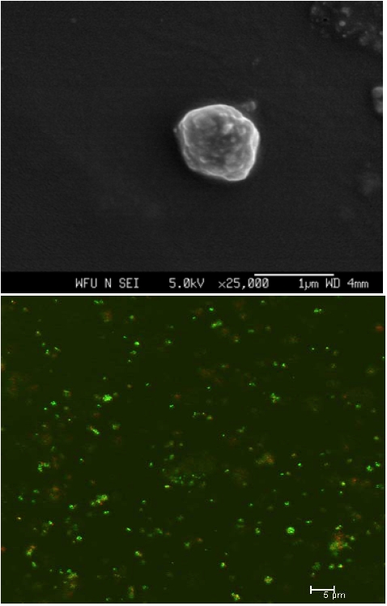
Highlights: Research
NanoTorrTM
Plasmonic nanoparticles are used to create mico-pressure sensors
New developments this year have allowed for physiologically important pressure detection in compartment syndrome and in open trauma!
Recently, we have achieved pressure sensing in animals so fine, that we can actually watch the heart beat.
Completely replaces the wick catheter and this Molar catheter.
Plastics/Ortho/Physics/Cancer -Licensed to Orthovative Tech

Slide 27


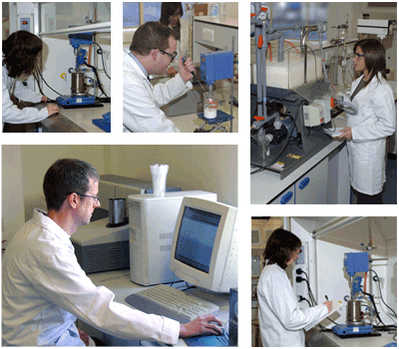
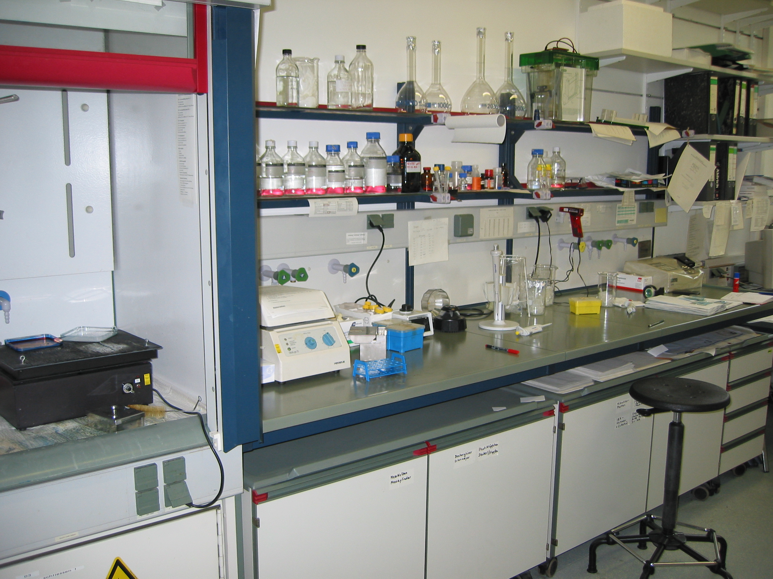
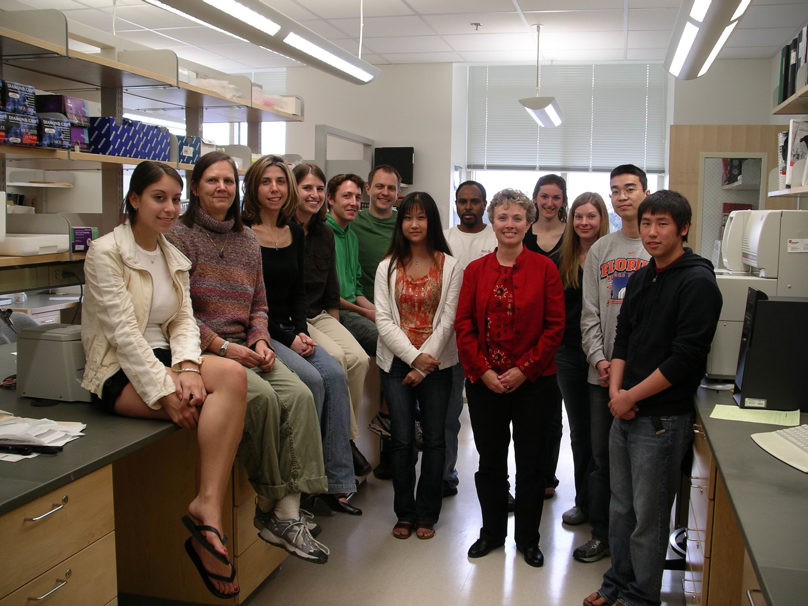


Our Model for Research…
VCs
Angel investors
Partnerships
Federal Dollars
Seed Money
Development of Prototypes
Consultation with
OTAM
Business manager
Basic Science
Teams are formed
Postdocs
Senior scientists
Undergraduates
Graduate students
ROI $$$
Reputation
Education
Community Impact

Slide 28


Our Model for Research…
Fields of Impact
In vivo sensing technologies
New imaging modalities for medical research
Design of Novel Cancer therapeutics
Ablative approaches to Cancer
nanoMechanics of metastasis
Antibiotic resistance in organisms
Tissue scaffolds and smart tissue constructs
Bioprinting and rapid prototyping
Orthopaedics
Microbiology- bacterial glycocalyx
Neuro-muscular disease
Cardio-thoracic
Early responder technologies
Diabetes
Renal disease
Solar collection technology
Thermal-Solar
Thermoelectrics
Organic thin film transistors
Battery technology
Structural composites
Lighting
Display technologies
IR sensors
IR-vision
Standoff detection
Sensor protection
GreenTech
Bionics/
Biomedical Green

Slide 29
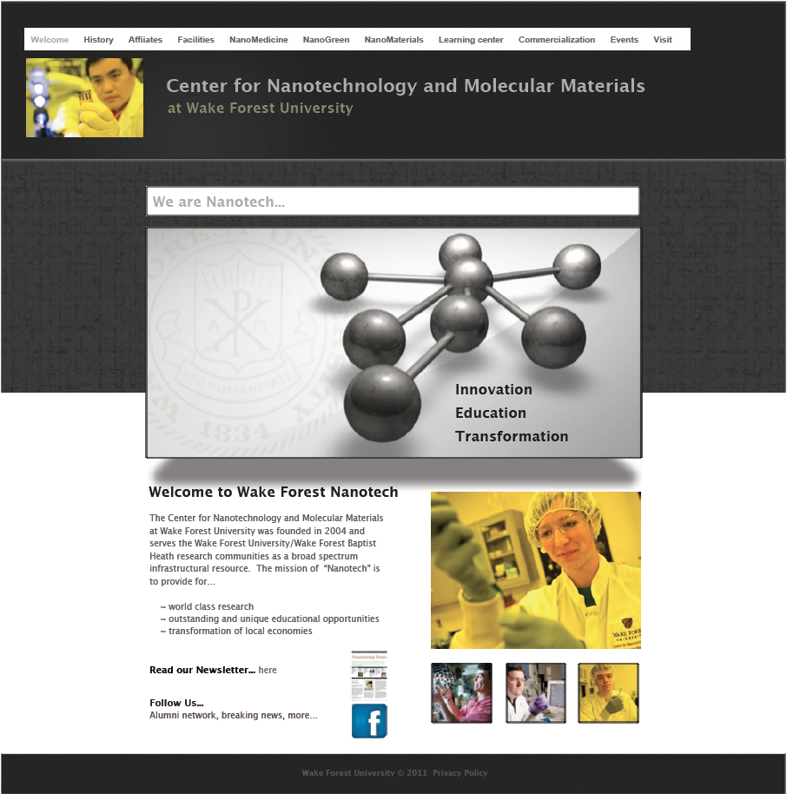
WWW.WFU.WDU/NANOTECH
Working with the Center is easy…
and this year our web portal has been upgraded making it even easier to work with us.
We also maintain a quarterly newsletter to let faculty and alumni know what is happening at Wake.
Most events of the Center are open to the public.
The Center welcomes between 10 and 15 tour groups a year.

Slide 30
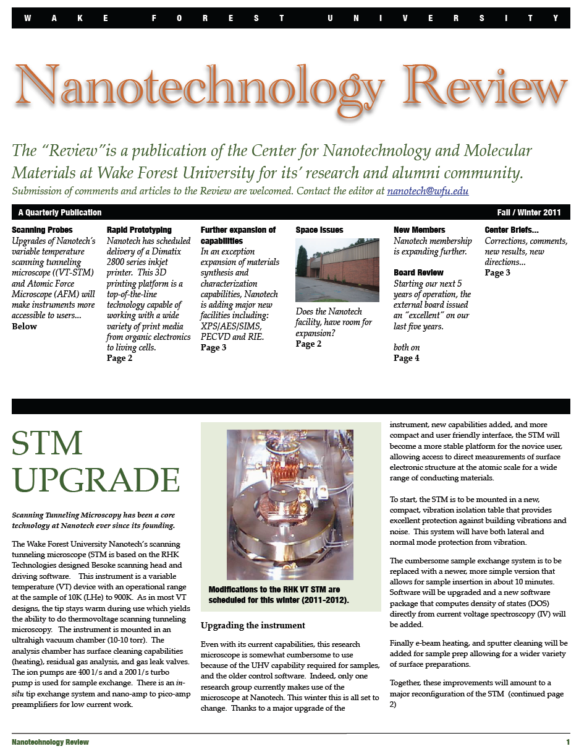
Did we leave anything out?
Programs reviews for Swiss Science Foundation
Technology Review for Korean Government
Technology Review for Office of the Secretary of the Navy
Program reviews for the Russian Federation
Program reviews for AFOSR and ARO
Program reviews for Irish National Science Foundation
NSF panels (4 last year)
Center visits by VIPs such as: AFOSR program heads, heads of several VC funds, state and local officials
Seminar Series for Nanotechnology between campuses
Educational metrics: best practices for diversity training and retention.
Alumni Newsletter

Slide 31
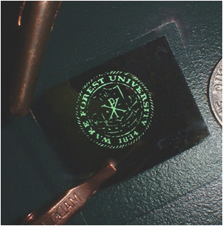
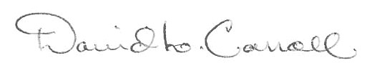
End of Report
On behalf of the affiliates of Nanotech

